Slide 1






DIFFERENCE OF SQUARES
Let’s examine a special product: (a + b)(a - b)
What is the SAME about the two binomials?
What is DIFFERENT about the two binomials?
same two terms
a & b
different signs between terms
+ & -
EXPAND (FOIL) and SIMPLIFY (COLLECT LIKE TERMS):
(x + 9)(x – 9)
(x + 4)(x – 4)
(2x + 5)(2x – 5)
$${=x}^{2}−9x+9x−81$$
$$=x^{2}−4x+4x−16$$
$$=4x^{2}−10x+10x−25$$
$$=x^{2}−81$$
$$=x^{2}−16$$
$$=4x^{2}−25$$

Slide 2
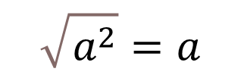
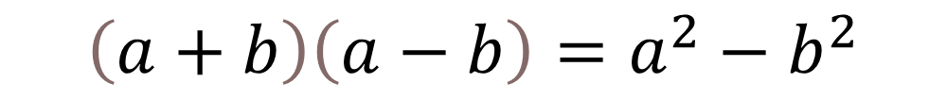
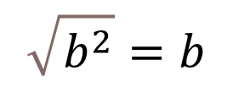
TO EXPAND SIMPLIFY THIS SPECIAL PRODUCT, USE THE FORMULA:
$$\left(a+b\right)\left(a−b\right)=a^{2}−b^{2}$$
The result is called a difference of squares. Two perfect squares being subtracted.
NOTE THESE PERFECT SQUARES – AND THEIR SQUARE ROOTS:
$$\sqrt{a^{2}}=a$$
$$\sqrt{b^{2}}=b$$

Slide 3







Today we will learn to recognize and factor these difference of squares.
HOW TO SPOT A DIFFERENCE OF SQUARES
only has 2 terms
subtraction
both terms are perfect squares
subtraction
subtraction
$$x^{2}−16$$
$$4y^{2}−49$$
$$\sqrt{x^{2}}=x$$
$$\sqrt{16}=4$$
$$\sqrt{4y^{2}}=2y$$
$$\sqrt{49}=7$$
both are perfect squares
both are perfect squares

Slide 4






FACTORING A DIFFERENCE OF SQUARES
When you can recognize a difference of squares,
it is easy to reverse the process and find the factors.
“Factoring” means Factor: x² – 49
find the binomials
that “FOIL” to
this expression!
$$\sqrt{x^{2}}$$
$$\sqrt{49}$$
$$=x$$
$$=7$$
$$=\left(x+7\right)\left(x−7\right)$$
Notice the signs between the factors.
One will always have a _____ and the other will always have a _____.
+
-

Slide 5














$$x^{2}−64$$
$$x^{2}−16$$
$$25x^{2}−36$$
$$9x^{2}−121$$
$$\left.(\right.$$
$$x$$
$$−$$
$$8$$
$$\left.)\right.$$
$$\left.(\right.$$
$$x$$
$$+$$
$$8$$
$$\left.)\right.$$

Slide 6






















FACTOR. You will have to COMMON FACTOR FIRST!!
$$2x^{2}−50$$
$$3x^{2}−48$$
$$2\left(x^{2}−25\right)$$
$$3\left(x^{2}−16\right)$$
$$−$$
$$+$$
$$2$$
$$x$$
$$+$$
$$3$$
$$x$$
$$4$$
$$x$$
$$4$$
$$−$$
$$5$$
$$x$$
$$5$$

Slide 7















$$5x^{2}−500$$
$$75x^{2}−27$$
$$5\left(x^{2}−100\right)$$
$$3\left(25x^{2}−9\right)$$
$$3$$
$$5x$$
$$−$$
$$3$$
$$3$$
$$5$$
$$x$$
$$+$$
$$5x$$
$$+$$
$$−$$
$$10$$
$$x$$
$$10$$

Slide 8









The area of the top of a classroom desk is represented by the expression 2500 – x².
Determine the length and width of the desk
2500 – x²
$$\sqrt{2500}$$
$$\sqrt{x^{2}}$$
A = 2500 – x²
( )( )
$$A=$$
$$50$$
$$−$$
$$x$$
$$50$$
$$+$$
$$x$$
Width
Length

Slide 9
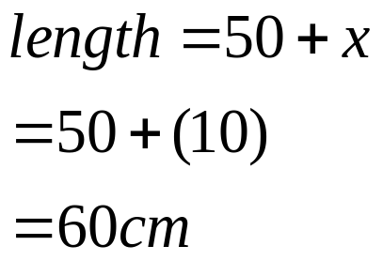
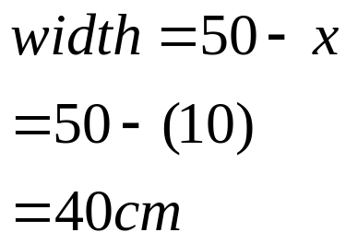
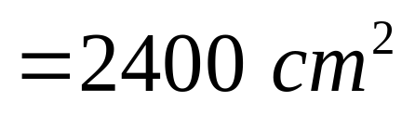




$$A=\left(50−x\right)\left(50+x\right)$$
b)
c)
$$A=2500−x^{2}$$
$$=2500−{\left(10\right)}^{2}$$
$$=2500−100$$

